Slide 1
Bits & Bytes: Group Choice
Wednesday, March 15, 2023
Facilitator:
Tami Saj
Notes:
Title slides
There are five different title slide image options. Text boxes can be customized or deleted.
Add a slide: Under the ‘Home’ menu, click on ‘New Slide’ and select the layout you would like to use.
Duplicate a slide: In the left navigation window, right-click on the slide you would like to duplicate and select ‘Duplicate Slide’.
Delete a slide: In the left navigation window, right-click on the slide you would like to delete and select ‘Delete Slide’.

Slide 3
Web address:
oer.royalroads.ca
Google search terms:
Royal Roads OER
Page name:
Bits & Bytes

Slide 4
Bits & Bytes Series

Slide 5
What are Bits & Bytes sessions?
Drop-in, single-topic, practical sessions about teaching with technology at RRU
Offered on an ongoing basis on the first Wednesday of each month, at 12:00pm – 12:30pm
Sessions will include a demo and explanation + time for Q&A
No registration or participation required! Just show up. ☺
Cameras and microphones are optional, so please feel free to simply listen while you enjoy your lunch.
Use the same link & password each time.

Slide 6
Group Choice
You create:
A poll
Team/grouping names
Based on student poll answers, Group Choice populates teams for:
Team activities
Team resources

Slide 7
Why Use Group Choice?
Frees up more instructor time to focus on course content
Increased student autonomy by making choice in a course = increased engagement

Slide 8
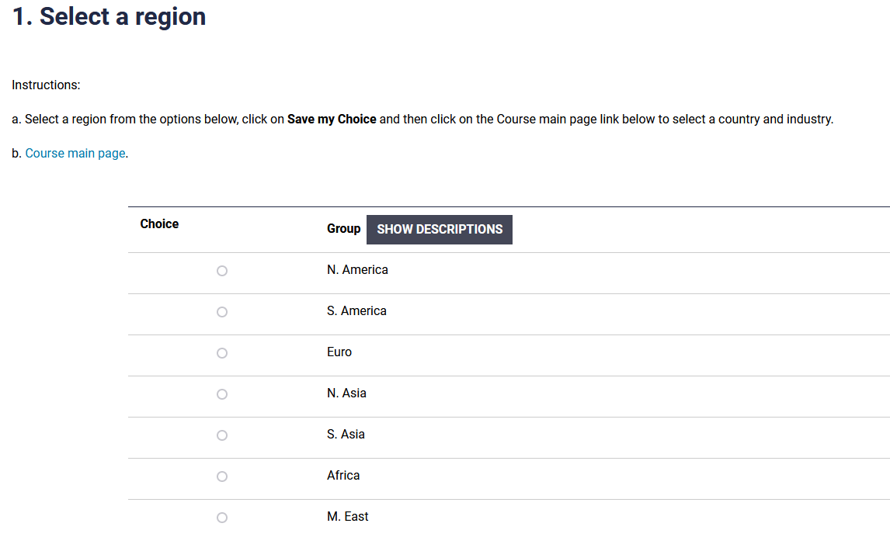
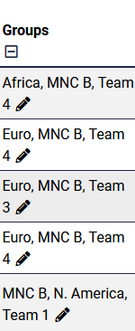
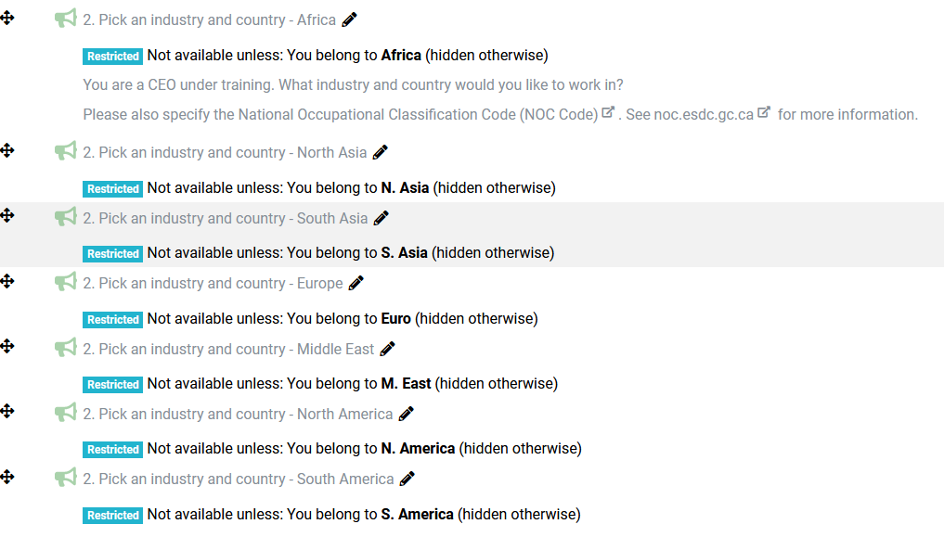
Group Choice Example 1

Slide 9
Group Choice Example 2

Slide 10
Group Choice Examples
Facilitating Learning Online (FLO) –facilitation team
Successful Team Based Learning (STBL) – team activities
Hidden course content

Slide 11
Q&A

Slide 12
Thank you!
royalroads.ca/ctet

