Slide 1
Bits & Bytes: Moodle Profiles
Wednesday, February 15, 2023
Facilitator: Lauren Stedman
Notes:
Title slides
There are five different title slide image options. Text boxes can be customized or deleted.
Add a slide: Under the ‘Home’ menu, click on ‘New Slide’ and select the layout you would like to use.
Duplicate a slide: In the left navigation window, right-click on the slide you would like to duplicate and select ‘Duplicate Slide’.
Delete a slide: In the left navigation window, right-click on the slide you would like to delete and select ‘Delete Slide’.

Slide 3
Web address:
oer.royalroads.ca
Google search terms:
Royal Roads OER
Page name:
Bits & Bytes

Slide 4
Bits & Bytes Series

Slide 5
What are Bits & Bytes sessions?
Drop-in, single-topic, practical sessions about teaching with technology at RRU
Offered on an ongoing basis on the first and third Wednesday of each month, at 12:00pm – 12:30pm
Sessions will include a demo and explanation + time for Q&A
No registration or participation required! Just show up. ☺
Cameras and microphones are optional, so please feel free to simply listen while you enjoy your lunch.
Use the same link & password each time.

Slide 6
Moodle Profiles
Today we will look at:
Why it’s good to add a profile
How to add your profile
Adding your pronouns
Where to find your student/participant profiles

Slide 7
Updating your Moodle Profile
Why complete your Moodle profile?
Helps the learning community get to know each other
Humanizes the online learning environment
Makes it easy to get and stay in touch
Things to consider:
Picture
Pronouns/nickname
City/town, Country
Time zone
Description
NOTE: Profiles don’t cross over to other instances of Moodle!

Slide 8
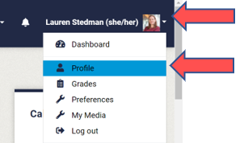
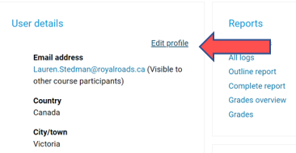
How to update your Moodle Profile
Step 1: Step 2:
r

Slide 9
Adding in your Pronouns
Use the “Alternate name” field to add your pronouns

Slide 10
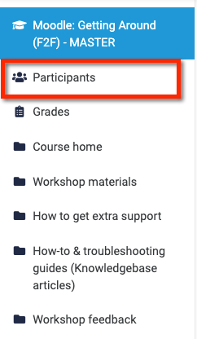
How to view other Moodle Profiles
Click on the picture or name of the person whose profile you wish to view.

Slide 11
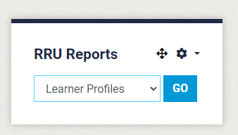
Get a report of student profiles
You can grab a report of your student profiles
r

Slide 12
Q&A

Slide 13
Thank you!
ctet.royalroads.ca

