Slide 1
Pedagogical Values Series: Assignment design for collaborative learning
January 26, 2023
Facilitators:
Lauren Halcomb-Smith, CTET
Robin Mueller, SET
Notes:
Title slides
There are five different title slide image options. Text boxes can be customized or deleted.
Add a slide: Under the ‘Home’ menu, click on ‘New Slide’ and select the layout you would like to use.
Duplicate a slide: In the left navigation window, right-click on the slide you would like to duplicate and select ‘Duplicate Slide’.
Delete a slide: In the left navigation window, right-click on the slide you would like to delete and select ‘Delete Slide’.

Slide 3
Web address:
oer.royalroads.ca
Google search terms:
Royal Roads OER
Page name:
Pedagogical Values Series

Slide 4
The Pedagogical Values Series

Slide 5
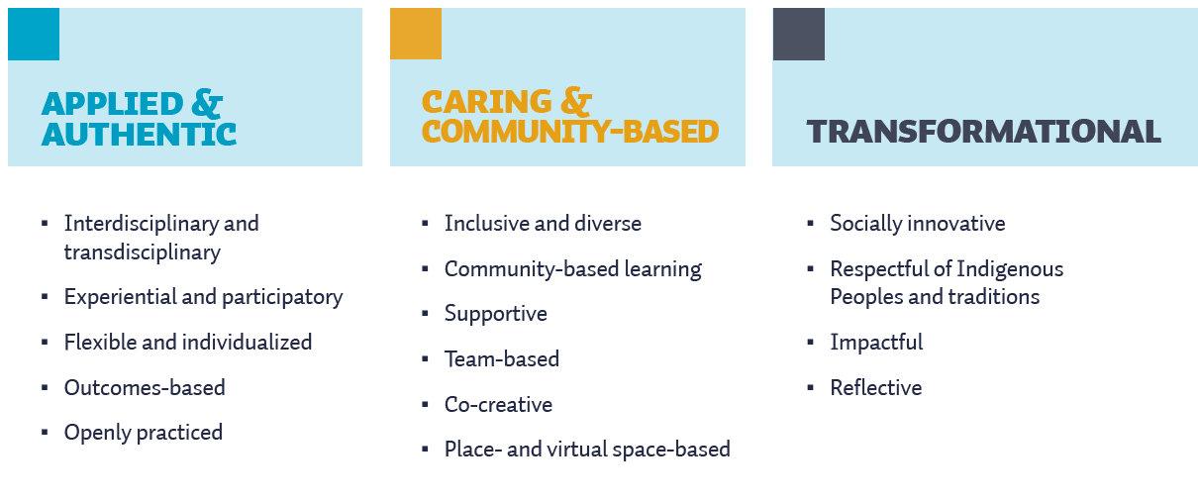
Learning, Teaching, & Research Model (LTRM)

Slide 6
Pedagogical Values
Pedagogical values refer to the worldviews, beliefs, perspectives, and biases about teaching and learning that underpin our specific educational practices (Palahicky et al., 2017). In other words, they are the belief systems that inform the decisions that we make at the micro and macro level of our teaching, from how we design learning experiences to how we interact and engage with learners.

Slide 7
“Inquiry-Based Learning: Enabling Transformation in Teaching and Learning”
Dr. Robin Mueller
Program head, Master of Arts in Higher Education Education Administration and Leadership (MAHEAL)
Notes:
Content slides
There are 10 different content slide layout options. Text boxes can be customized or deleted.
Add a slide: Under the ‘Home’ menu, click on ‘New Slide’ and select the layout you would like to use.
Duplicate a slide: In the left navigation window, right-click on the slide you would like to duplicate and select ‘Duplicate Slide’.
Delete a slide: In the left navigation window, right-click on the slide you would like to delete and select ‘Delete Slide’.

Slide 8
Q & A / Discussion
Do you think this way of teaching is too “labour-intensive” and “time-consuming”?
Do you think it is possible to try this way in the courses you are teaching? Why or why not?
Do you think online wiki could replace this way of teaching? Why or why not?

Slide 9
Thank you!
ctet.royalroads.ca

