Slide 1
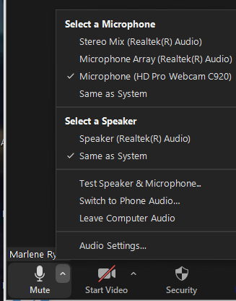
WELCOME!
WHILE YOU WAIT
Make sure you logged in using either Google Chrome or Firefox.
Use a headset (earphones & microphone).
Set up your camera (tiny menu beside Start Video)
Set up your microphone (tiny menu beside Mute).
Say ‘hello’ in the text chat area.
Note: If you decide to use a toll number to join a Zoom meeting, you will be charged based on the rates of your phone service provider.

Slide 2
Acknowledgment of traditional lands
This slide is the RRU-specific acknowledgment slide that CAN be edited if required…
Please DELETE either slide 2 or slide 3 before your presentation.
Royal Roads University acknowledges that we live, learn and work on the traditional lands of the Xwsepsum (Esquimalt) and Lkwungen (Songhees) ancestors and families, who have lived, hunted, fished and gathered here since time immemorial, and who shared these traditional land resources with the neighbouring Scia’new (Beecher Bay) and T’Sou-ke (Sooke) Nations.
It is with gratitude that we now work and learn on these lands, where the past, present and future of Indigenous and non-Indigenous students, faculty and staff come together.
Hay’sxw’qa si’em!

Slide 3
Closing Session: Graduate Certificate in
Instructional Design
Graduate Diploma in
Technology-Enhanced Learning and Design

Slide 4
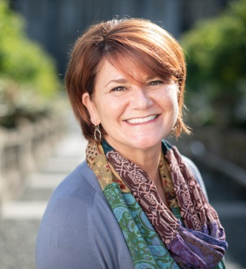
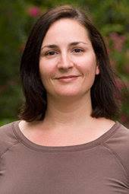
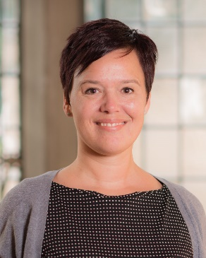
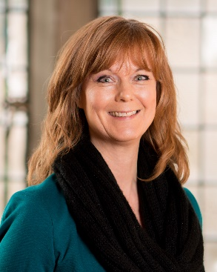
Re-Introduction to School of Education and Technology
© Royal Roads University
© Royal Roads University
© Royal Roads University
© Royal Roads University
Doug
Hamilton
Acting Program Head
Graduate Certificate in Instructional Design, &
Graduate Diploma in Technology-enhanced Learning and Design
Tamara Leary
School
Director
Samantha Wood
School Manager
Kellie-Ann Harvey
Program Coordinator
Marlene
Ryan
Program Associate

Slide 5
Agenda
Meet your IDSN 521, 522 and 520 instructors
Resources
Reminders
Next steps
Feedback
© Dahlquist-Axe Design Ltd

Slide 6
IDSN 521:
Graphic Design for Instructional Designers

Slide 7
Introduction
© Royal Roads University
Ken Jeffery
M.A.
Instructional Designer, CTET
Associate Faculty, School of Education and Technology

Slide 8
IDSN 522:
Project Management for
Instructional Designers

Slide 9
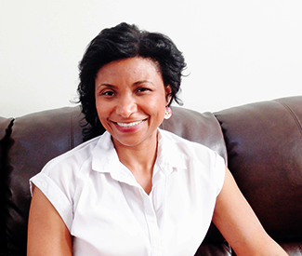
Introduction
Sophia Palahicky
MDE, EdD
Associate Director, CTET
Associate Faculty, School of Education and Technology

Slide 10
IDSN 520:
Instructional Design for Tech-Enhanced Learning

Slide 11
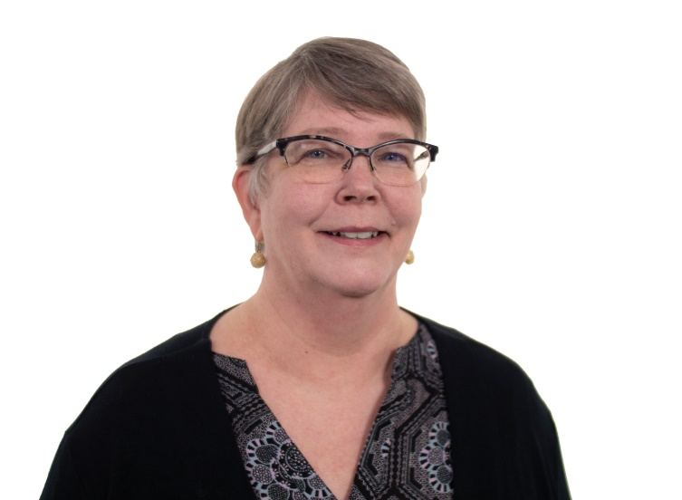
Introduction
Jenni Hayman
PhD
Associate Faculty Member, School of Education and Technology

Slide 12
IDSN520: Instructional Design for Tech-Enhanced Learning
Engages students in exploring a systematic approach to the design, development, and evaluation of technology-enhanced learning environments.
Enables students to create technology-enhanced learning environments that demonstrate effective and meaningful integration and synthesis of instructional design and technology concepts and principles.

Slide 13
Resources

Slide 14
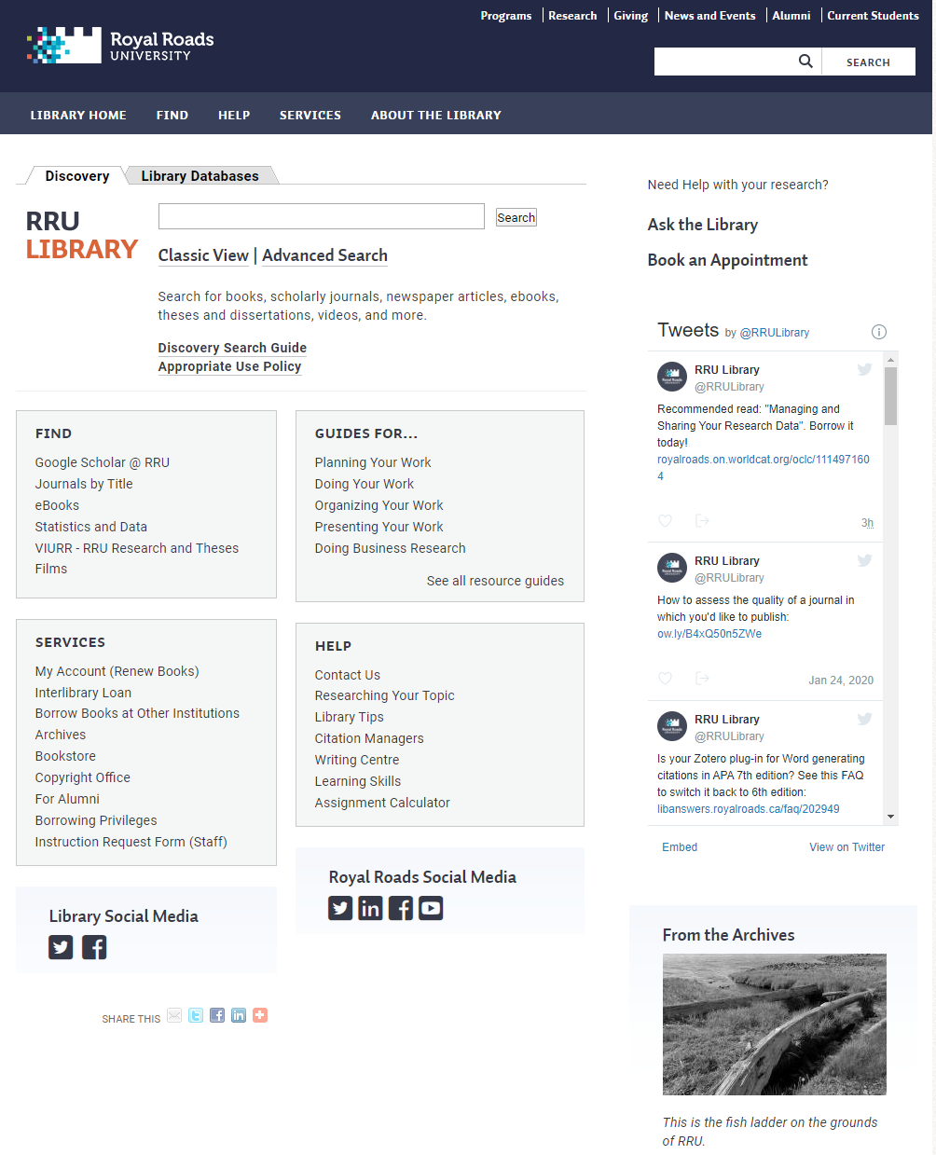
The Library
http://library.royalroads.ca

Slide 15
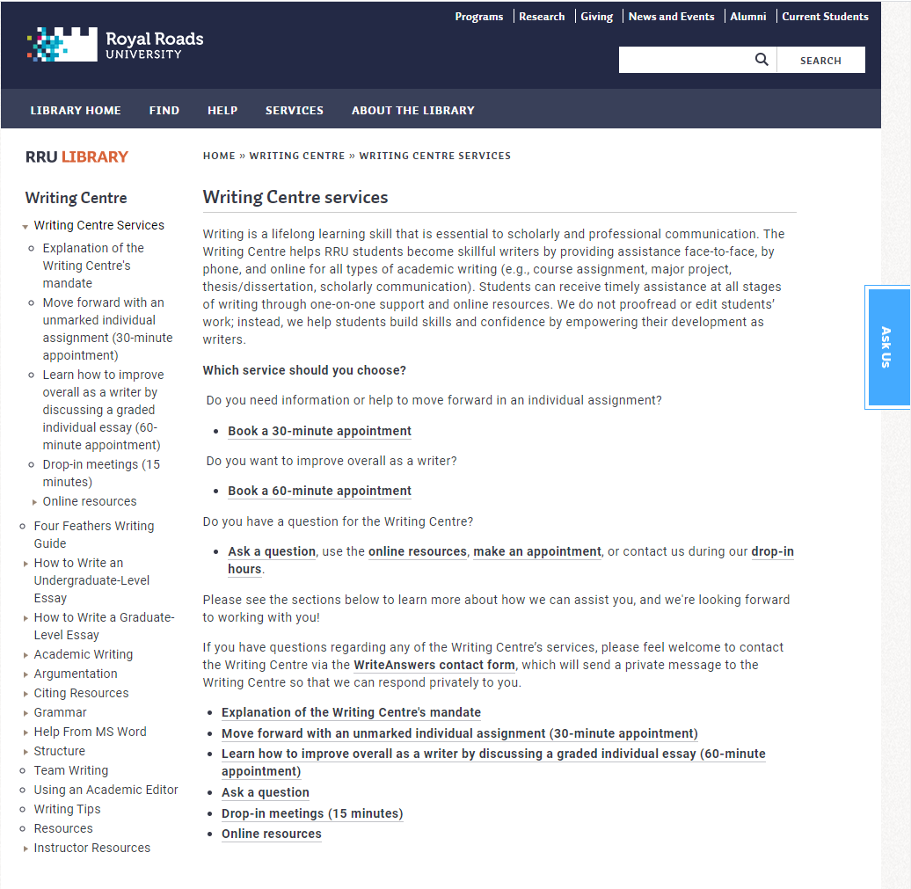
The Writing Centre
http://library.royalroads.ca/writing-centre/writing-centre-services

Slide 16
Team Resources
Team Coaching Services
Learning in Teams
Communication
Team Agreements
Diversity
Common Challenges
Conflict Resolution
Feedback and Reflection
© Royal Roads University
https://teamwork.royalroads.ca/students

Slide 17
Team Resources
© Royal Roads University
https://moodle.royalroads.ca/moodle/mod/folder/view.php?id=564461

Slide 18
Reminders…

Slide 19
Complete…
…the Introduction to Academic Integrity course
…The Link’s Week 1 and Week 2 quizzes
© Royal Roads University

Slide 20
Stay Connected…
…with each other, your instructors, and the program office
© Royal Roads University

Slide 21
Congratulations, and remember…
© Royal Roads University
…to keep the big picture in mind, and hold on to your sense of humour

Slide 22
Next Steps
IDSN 521 will be starting on January 31, 2022
© Dahlquist-Axe Design Ltd

Slide 23
?

Slide 24
Contact Information
Doug Hamilton
Acting Program Head
Doug.Hamilton@RoyalRoads.ca
Marlene Ryan
Program Associate
Marlene.1Ryan@RoyalRoads.ca

